Slide 1
Measuring Algorithms
By Deogratias Shidende, RUCU

Slide 2
Algorithm
An algorithm is a step by step process that describes how to solve a problem
When there are multiple algorithms for a particular problem (and there often are!), the best algorithm is typically the one that solves it the fastest while using minimal resources
How do we know this algorithm is efficient or better than that algorithm,,,,, we should measure it
This section elaborates on how to measure algorithm by using big-O notation

Slide 3
Expressing an Algorithm
Natural language
It is natural and can be understood by non-programmers
Problem: It has no imposed structure and hence it is sometimes ambiguous and vaguely defined
Flow charts
It has a structured format and can express the algorithm precisely
Pseudocode
It is structured format and can express the algorithm precisely
May not be understood by non-programmers
Actual programming languages.

Slide 4
Example
Write an algorithm to convert binary number to decimal number, then write a java method to implement this algorithm.

Slide 5
Algorithmic Complexity with Big O Notation
Algorithmic complexity is a way to describe the efficiency of an algorithm as a relation of its input.
It can be used to describe various properties of our code, such as runtime speed or memory requirements.
It's also a very important tool programmers should understand to write efficient software.

Slide 6
Time complexity
Time complexity is the execution time it takes for the algorithm to solve a problem.
It is driven by two things i.e. execution time & the space required by the program
Why it is important to measure it?
In order to improve the efficiency of code we are writing
How do we measure time complexity?
By using Big O Notation where the letter O means Order of the program.

Slide 7
Big O Notation
Big O Notation is a mathematical expression that is used to measure the time complexity by classifying how the program behaves with varying input and taking in different operations.
It is written as O(expression)
When evaluating the expression in big O notation
Rule 1: Take the high order of polynomial
Rule 2: Ignore the constants, ie O(c)=O(1), O(cn)=O(n), c=constant
Examples: The big O of expression 2+4n-3n²+5n³
By rule 1: O(2+4n-3n²+5n³) = 5n³
By rule 2: O(5n³) = O(n³)

Slide 8
Types of Big O Notation
Constant-Time Algorithm aka O(1) aka Order 1
This is the fastest time complexity
It does not matter what’s the size of the input, the execution and the space required to run this will be the same.
Example: Accessing an element in array, for an array A of size n, it will always takes 1 iteration to access an element in this array, ie O(1)

Slide 9
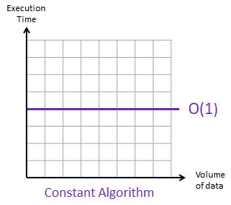
Examples
Find if a number is even or odd.
Check if an item on an array is null.
Print the first element from a list.
Find a value on a map

Slide 10
Linear-Time Algorithm aka O(n) aka Order n
Linear Time complexity depends on the input size i.e directly proportional
Example: Printing the elements from the array, or finding the element in the array by scanning the element one by one
The following algorithm is called linear search, it searches for a target from an input array and return the position of target if found or -1 if not found
public int LinearSearch(int target) {
for (int i = 0; i < numbers.length; i++) {
if (numbers[i] == target) {
return i;
}
}
return -1;
}
Note:
The array numbers is declared as data member

Slide 11
Linear-Time Algorithm Analysis
The best case
This occurs when we are lucky,
for linear search algorithm, when our target is the first number in the array. In which case, the time complexity will be O(1)
The Worst case
When the algorithm has to execute to the last element
For linear search algorithm, the worst case is either when the target is located at the last element or not found the array, thus the time complexity will be O(n)
The average case
This is between worst case and best case.
When an element is located in between the array.
The time complexity is O(n)

Slide 12
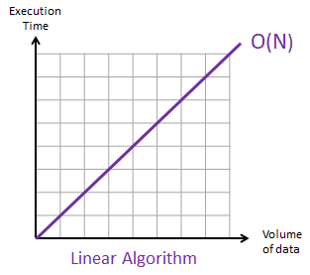
Examples
Get the max/min value in an array.
Find a given element in a collection.
Print all the values in a list.

Slide 13
Quadratic-Time complexity - O(n²) - Order N Squared (Or Polynomial Time Complexity)
The time to execute a program is proportional to the square of the input size.
It is slower than linear time complexity
Algorithms which are based on nested loops are more likely to have a quadratic O(N²), or cubic (N³)

Slide 14
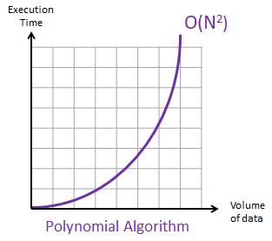
Examples
Check if a collection has duplicated values.
Sorting items in a collection using bubble sort, insertion sort, or selection sort.
Find all possible ordered pairs in an array

Slide 15
public boolean containsDuplicates() {
for (int i = 0; i < numbers.length-1; i++) {
for (int j = 0; j < numbers.length-1; j++) {
if (i != j && numbers[i] == numbers[j])
return true;
}
}
return false;
}
Algorithm to find the duplicate in an array
Assume the array size is n
Best case:
when the duplicate numbers are in the front of the input array
The inner loop executes only twice and outer loop stops at i=0, ie O(1*2)= O(2)=O(1)

Slide 16
Worst case
When the array doesn't contain duplicate numbers
The outer loop executes n times and therefore, inner loop executes n*n=n²
Thus, the time complexity is O(n²)
The average case: O(1+ n²)=O(n²)

Slide 17
Logarithmic-Time Algorithm - O(log n) - Order log N
It applies to algorithms that divide the input data and deals with the smaller parts of data
Among the fastest algorithm
As the input grows, the time complexity increases logarithmically

Slide 18
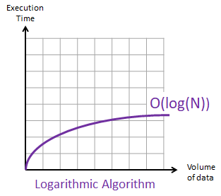
Example
Binary search
What is best case, average case and worst case scenario for binary search algorithm?

Slide 19
Binary search
public int binarySearch(int target){
int end = numbers.length - 1;
int start = 0;
while (start <= end) {
int mid = (end + start) / 2;
if (numbers[mid] == target)
return mid;
else if (numbers[mid] > target)
end = mid - 1;
else
start = mid + 1;
}
return -1;
}

Slide 20
Exponential Notation
The exponential notation O(2^{N}) describes an algorithm whose growth doubles with each addition to the data set.
Backtracking algorithms which test every possible “pathway” to solve a problem can be based on this notation. Such algorithms become very slow as the data set increases.
Example of exponential algorithm: An algorithm to list all the possible binary permutations depending on the number of digits (bits).

Slide 21
